Slide 1
COVID-19 Detection with X-ray Image Classification Using Cloud Computing Platforms
CSE 6250, Team 27
Instructor:
Group member:
Jimeng Sun
Fathima Said Mohamed Thotathil,
Anh L Tran, Ron He
Notes:
We designed this template so that each member of the project team has a set of slides with its own theme. Members, here’s how you add a new slide to just your set:
Mark where you want to add the slide: Select an existing one in the Thumbnails pane, click the New Slide button, then choose a layout. The new slide gets the same theme as the other slides in your set.
Careful! Don’t annoy your fellow presenters by accidentally changing their themes. That can happen if you choose a different theme from the Design tab, which changes all of the slides in the presentation to that look.

Slide 2
Agenda
Project Description
Methodology
Approaches and Results
Discussion
References

Slide 3
Project Description
Background:
Chest X-ray is a fast and effective diagnostic method for COVID-19 detection
Many deep learning models have been developed to detect Covid-19
Convolutional Neural Network (CNN)
ResNet50, ResNet101, ResNet152, InceptionV3 and Inception-ResNetV2
Machine learning models: SVM, Logistic Regression, Decision Tree, etc
DL frameworks: PyTorch and PySpark
Cloud computing platforms: AWS and DataBrick
Objective:
Using both PyTorch and PySpark frameworks with two pretrained models (i.e. ResNet50 and InceptionV3) for binary classification (COVID vs. No-findings) and multi-class classification (COVID vs. No-findings vs. Pneumonia) settings.

Slide 4
Methodology

Slide 5
Image Datasets
Index | Data Source | Amount
1 | COVID Chest x-ray dataset (multiple sources) - Cohen JP et al. [4] | 866 X-ray images total but only 782 are frontal view. Among 782 frontal view images, 18 No findings, 191 Pneumonia-No covid, and 478 Pneumonia-Covid
2 | COVID 19 dataset (Covid19 developed by Cohen + ChestX-ray8 database provided by Wang) - Ozturk et al. [6] | 127 Covid19 (these images are also in the #1 dataset), 500 no finding, 500 pneumonia
3 | COVID 19 Kaggle dataset (images from Italian Society of Medical and Interventional Radiology (SIRM) COVID-19 DATABASE, Novel Corona Virus 2019 Dataset developed by Joseph Paul Cohen) - Chowdhury et al. [5] | 219 Covid19 (include 158 images from #1), 1341 Normal, 1345 Viral Pneumonia
Sample dataset: #2
Full dataset: 4412 frontal chest X-ray images in three classes:
698 covid-19
1851 normal
1863 viral pneumonia
80% training: 20% testing

Slide 6
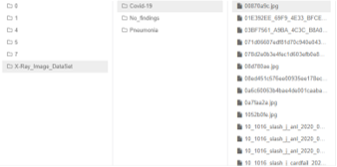
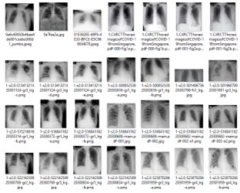
Image Datasets

Slide 7
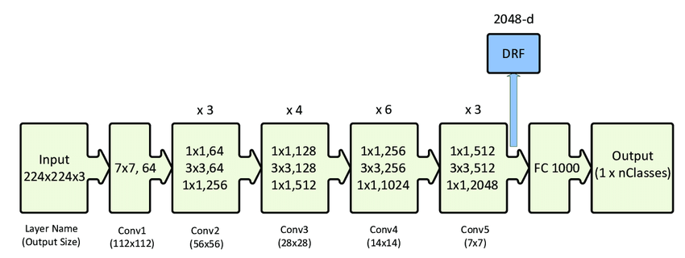
Models
ResNet-50
https://www.researchgate.net/figure/ResNet-50-architecture-26-shown-with-the-residual-units-the-size-of-the-filters-and_fig1_338603223

Slide 8
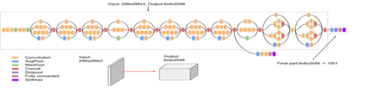
Models
InceptionV3
https://cloud.google.com/tpu/docs/inception-v3-advanced

Slide 9
Approaches and Results

Slide 10
PyTorch and Amazon SageMaker
Model development
Pretrained ResNet50 and InceptionV3 models
Transfer learning
Image processing: resize to 224x224 for ResNet-50 and 299x299 for InceptionV3, normalized with 0.485 mean and 0.229 standard deviation, and converted into multidimensional tensors using torchvision.transform package
GPU
Batches of 20
Cross-entropy loss function
SGD with learning rate 0.001
Adam with a learning rate of 3e-5
Epoch = 10

Slide 11
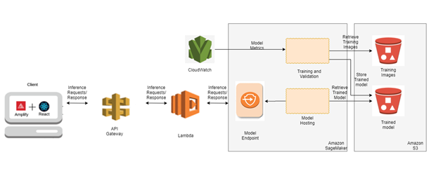
PyTorch and Amazon SageMaker
Model deployment

Slide 12
Results
Binary classification
Model | Precision (Covid Image only) | Recall (Covid Image only) | F1-score (Covid Image only) | Overall Accuracy
ResNet-50 - sample dataset (SGD; 0.001 learning rate) | 0.95 | 0.95 | 0.95 | 0.933
InceptionV3 - sample dataset (SGD; 0.001 learning rate) | 0.93 | 0.91 | 0.92 | 0.912
ResNet-50 - full dataset (Adam; 3e-5 learning rate) | 0.99 | 0.99 | 0.99 | 0.993
InceptionV3 - full dataset (Adam; 3e-5 learning rate) | 0.99 | 0.99 | 0.99 | 0.992

Slide 13
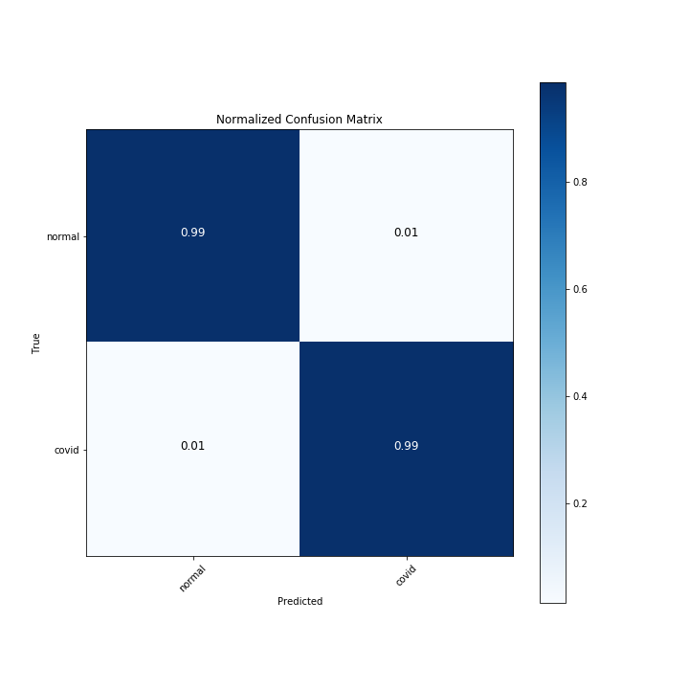

Results
ResNet-50
InceptionV3

Slide 14
Results
Multiclass classification
Model | Precision (Covid Image only) | Recall (Covid Image only) | F1-score (Covid Image only) | Overall Accuracy
ResNet-50 - sample dataset (SGD; 0.001 learning rate) | 0.95 | 0.80 | 0.87 | 0.871
InceptionV3 - sample dataset (SGD; 0.001 learning rate) | 0.88 | 0.84 | 0.86 | 0.833
ResNet-50 - full dataset (Adam; 3e-5 learning rate) | 0.95 | 0.91 | 0.93 | 0.950
InceptionV3 - full dataset (Adam; 3e-5 learning rate) | 0.85 | 0.91 | 0.88 | 0.910

Slide 15
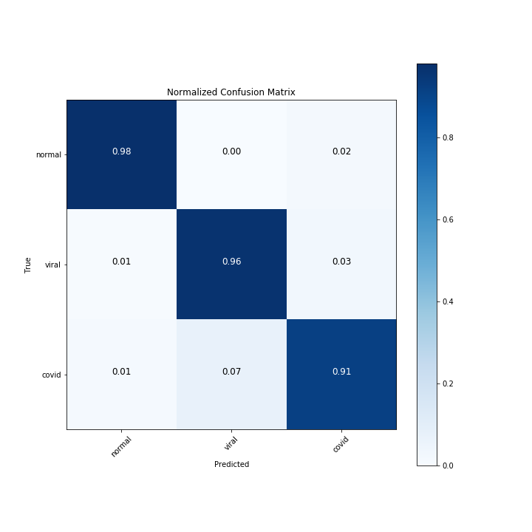
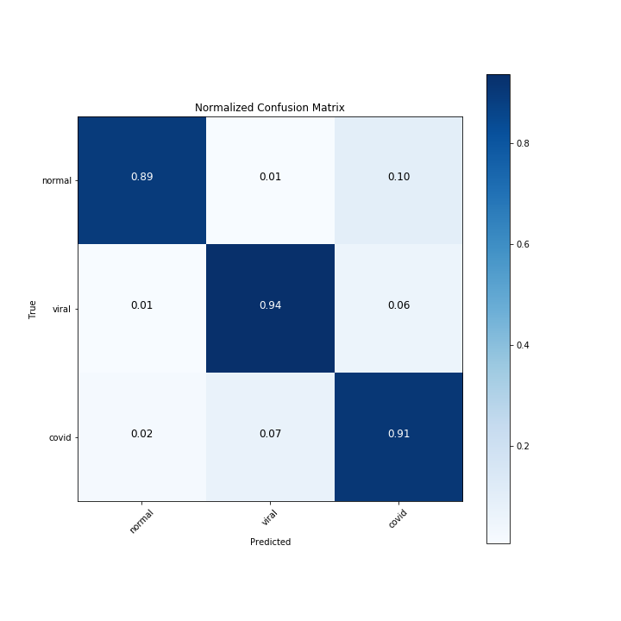
Results
ResNet-50
InceptionV3

Slide 16
Link to Demo Video of X-ray Image Prediction of Covid-19

Slide 17
PySpark and DataBricks

Slide 18
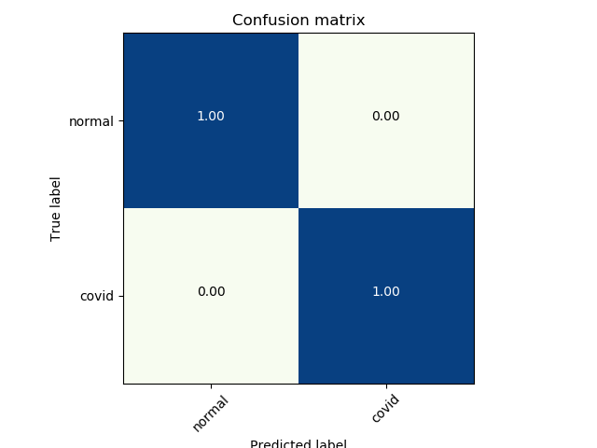
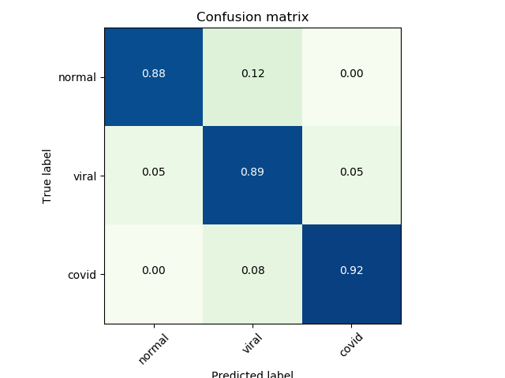
Best Model Confusion Matrix
ResNet50 and Logistic Regression Binary
ResNet50 and Logistic Regression Multi-Class

Slide 19
Discussion
Both the approaches yielded high accuracy when using the ResNet50 pretrained model compared to the InceptionV3
The accuracy of binary classification was higher than that of multiclass classification.

Slide 20
References
[1] Ilyas, M., Rehman, H., & Naït-Ali, A. (2020). Detection of Covid-19 From Chest X-ray Images Using Artificial Intelligence: An Early Review. arXiv preprint arXiv:2004.05436.
[2] Shi, F., Wang, J., Shi, J., Wu, Z., Wang, Q., Tang, Z., ... & Shen, D. (2020). Review of artificial intelligence techniques in imaging data acquisition, segmentation and diagnosis for covid-19. IEEE reviews in biomedical engineering.
[3] Narin, A., Kaya, C., Pamuk, Z. (2020). Automatic Detection of Coronavirus Disease (COVID-19) Using X-ray Images and Deep Convolutional Neural Networks. arXiv preprint arXiv:2003.10849.
[4] Cohen, J. P., Morrison, P., & Dao, L. (2020). COVID-19 image data collection. arXiv preprint arXiv:2003.11597.
[5] Chowdhury, M. E., Rahman, T., Khandakar, A., Mazhar, R., Kadir, M. A., Mahbub, Z. B., ... & Reaz, M. B. I. (2020). Can AI help in screening viral and COVID-19 pneumonia?. arXiv preprint arXiv:2003.13145.
[6] Ozturk, T., Talo, M., Yildirim, E. A., Baloglu, U. B., Yildirim, O., & Acharya, U. R. (2020). Automated detection of COVID-19 cases using deep neural networks with X-ray images. Computers in Biology and Medicine, 103792.
[7] Sethy, P. K., Behera, S. K., Ratha, P. K., & Biswas, P. Detection of coronavirus Disease (COVID-19) based on Deep Features and Support Vector Machine.
[8] Yoo, S. H., Geng, H., Chiu, T. L., Yu, S. K., Cho, D. C., Heo, J., ... & Min, B. J. (2020). Deep learning-based decision-tree classifier for COVID-19 diagnosis from chest X-ray imaging. Frontiers in medicine, 7, 427.
[9] Minaee, S., Kafieh, R., Sonka, M., Yazdani, S., & Soufi, G. J. (2020). Deep-covid: Predicting covid-19 from chest x-ray images using deep transfer learning. arXiv preprint arXiv:2004.09363.
[10] Kouanou, A. T., Tchiotsop, D., Kengne, R., Zephirin, D. T., Armele, N. M. A., & Tchinda, R. (2018). An optimal big data workflow for biomedical image analysis. Informatics in Medicine Unlocked, 11, 68-74.
[11] Mishra, Sanjukta (2018). A REVIEW ON BIG DATA ANALYTICS IN MEDICAL IMAGING, International Journal of Computer Engineering and Applications, Volume XII, Issue I, Jan. 2018.
[12] Ullah, R., & Arslan, T. (2020). PySpark-Based Optimization of Microwave Image Reconstruction Algorithm for Head Imaging Big Data on High-Performance Computing and Google Cloud Platform. Applied Sciences, 10(10), 3382.
[13] Mishra, Abhishek (2019). Machine learning in the AWS Cloud: add intelligence to applications with Amazon SageMaker and Amazon Rekognition, Sep. 2019.
[14] Lombog, M. (2020, May 21). Build a React App Using AWS Amplify in Simple Steps (Part 1). Retrieved November 15, 2020, from https://medium.com/better-programming/build-a-react-app-with-authentication-using-aws-amplify-49db1dfdc290

